Slide 1
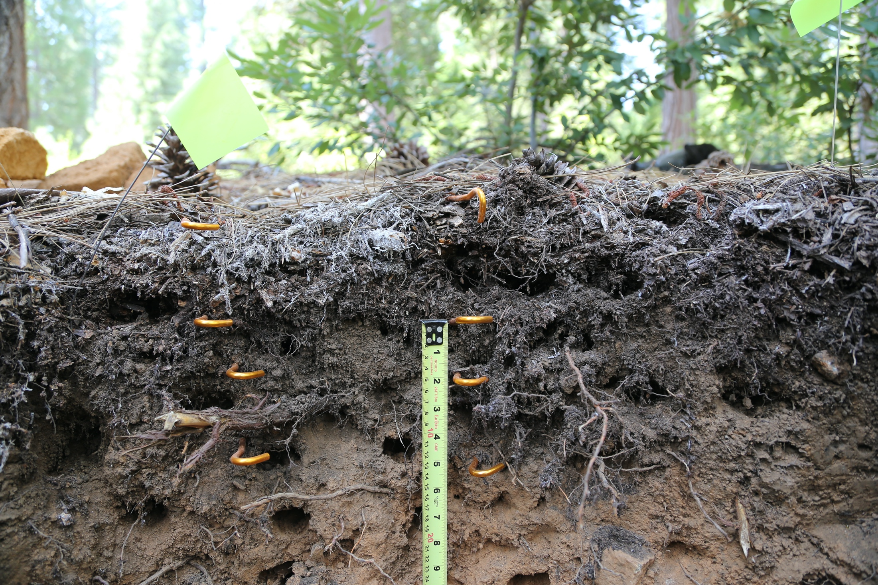
A New Global Synthesis of Soil Warming Experiments
Jeff Beem-Miller^{1,2},
S. Abiven, A. Malhotra, F. Protti Sánchez, P.B. Reich, W.J. Riley, C. Rumpel, M.W.I Schmidt, and M.S. Torn.
¹ Institute for Global Change Biology, University of Michigan,
² Climate and Ecosystem Sciences Division, Lawrence Berkeley National Laboratory
AGU Fall Meeting ‘23
11 Dec. 2023

Slide 2
How does warming affect soil C stocks?
J. Beem-Miller

Slide 3
inputs
+
How does warming affect soil C stocks?
+ decomposition
J. Beem-Miller
Notes:
So we have two competing pathways, one of which will lead to more storage of atmospheric CO2 in soils, the other of which will lead to soil carbon losses, potentially exacerbating warming
The positive pathway (in green) is driven by increases in carbon inputs to the soil
This is predicted to occur due to enhanced primary production in vegetation from both warming and increased atmospheric CO2 concentrations
The negative pathway (in red) predicts soil carbon losses due to increases in decomposition rates with warmer temperatures

Slide 4
SOIL C STOCK PREDICTIONS
inputs
+
500
250
Change in soil C stocks by 2100
(Pg C)
0
-250
-500
+ decomposition
Ensemble of global soil C models
Model mean
Multi-model mean
± sd
(figure adapted from Todd-Brown et al., 2018)
J. Beem-Miller
Notes:
Unfortunately, current global soil carbon models do not agree on the relative importance of these two pathways
The figure here is from a synthesis paper by Kathe Todd-Brown and others, and shows predicted changes in global soil carbon stocks by the end of this century [under a high emissions scenario relative concentration pathway of 8.5]
It’s worth noting that all models predict substantial increases in inputs, by a relative factor of 1.4, which is why the mean change is positive
[Multi-model mean of this increase is: 88 ±153 Pg C]
However, there less agreement with regards to the increased decomposition pathway

Slide 5
SOIL C STOCK PREDICTIONS
inputs
+
500
250
Change in soil C stocks by 2100
(Pg C)
0
-250
-500
+ decomposition
Ensemble of global soil C models
Model mean after adjusting temperature sensitivity (Q10)
Multi-model mean
± sd
(figure adapted from Todd-Brown et al., 2018)
J. Beem-Miller
Notes:
The authors of this study tried to improve the estimates of decomposition losses by rescaling the temperature sensitivity constant of decomposition in the models using data from soil warming experiments
What we can see is that after this rescaling, the multi-model mean declines [to 19 Pg C from 88 Pg C; similar sd]
But the overall picture is still one of confusion---the model estimates are all over the place
And this is partly because of the uncertainty about the temperature sensitivity of soil organic matter decomposition in the empirical data

Slide 6
Can we use
soil warming experiments
to illuminate
the key processes
driving potential
terrestrial C stock changes?
J. Beem-Miller

Slide 7
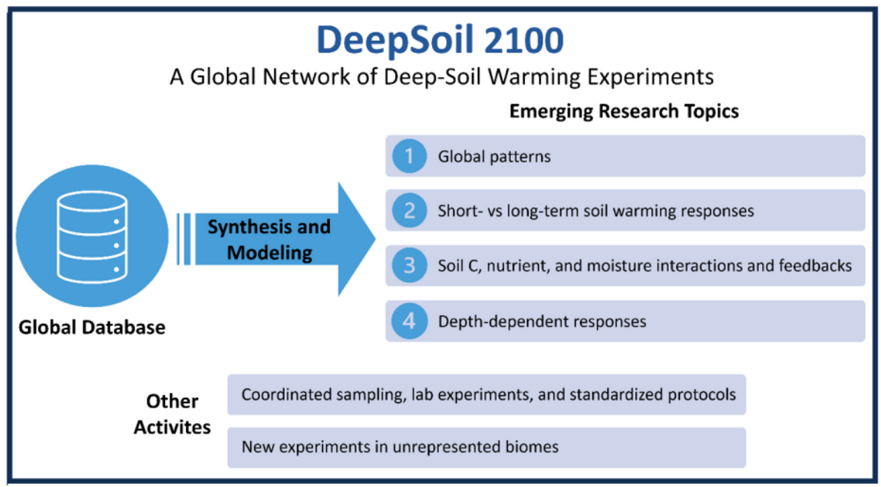
SYNTHESIS EFFORT
J. Beem-Miller

Slide 8
WHY DeepSoil 2100?
Whole soil warming
J. Beem-Miller
Notes:
Deep soils store large amounts of soil C, and the vulnerability of these soil C stocks to warming remains an open question

Slide 9
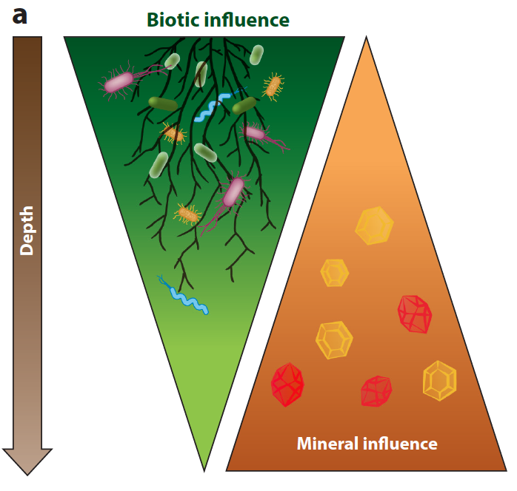
WHY DeepSoil 2100?
Whole soil warming
(figure from Hicks Pries et al., 2023)
J. Beem-Miller
Hicks Pries et al., 2023. The Deep Soil Organic Carbon Response to Global Change. Annu. Rev. Ecol. Evol. Syst. 2023. 54:375–401
Notes:
Deep soils store large amounts of soil C, and the vulnerability of these soil C stocks to warming remains an open question

Slide 10
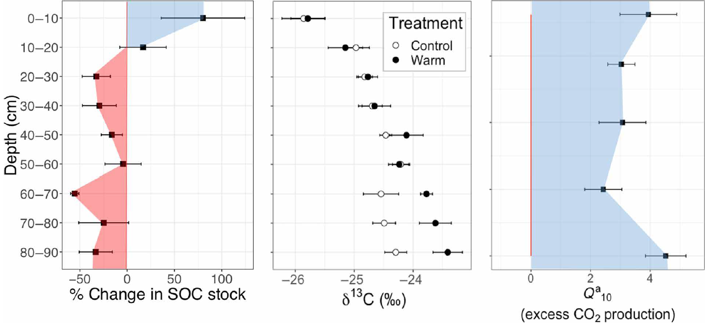
WHY DeepSoil 2100?
Blodgett Forest
+ 4 °C
(figure from Soong et al., 2021)
J. Beem-Miller
Soong et al., 2021. Five years of whole-soil warming led to loss of subsoil carbon stocks and increased CO2 efflux. Sci. Adv.
Notes:
Losses observed in subsoil
non-sig gains in top 20 cm
1/3 of SOC stocks after just 4 and half years of warming (3.21±1.0 kg C m−2)
Primarily particulate organic matter

Slide 11
WHY DeepSoil 2100?
Blodgett Forest
+ 4 °C
(figure from Soong et al., 2021)
J. Beem-Miller
Soong et al., 2021. Five years of whole-soil warming led to loss of subsoil carbon stocks and increased CO2 efflux. Sci. Adv.
Notes:
30% increase in CO2 production over the whole soil profile
Difference in top soil and subsoil processes

Slide 12
WHY DeepSoil 2100?
Whole soil warming
J. Beem-Miller

Slide 13
WHY DeepSoil 2100?
Whole soil warming
Global network
J. Beem-Miller

Slide 14
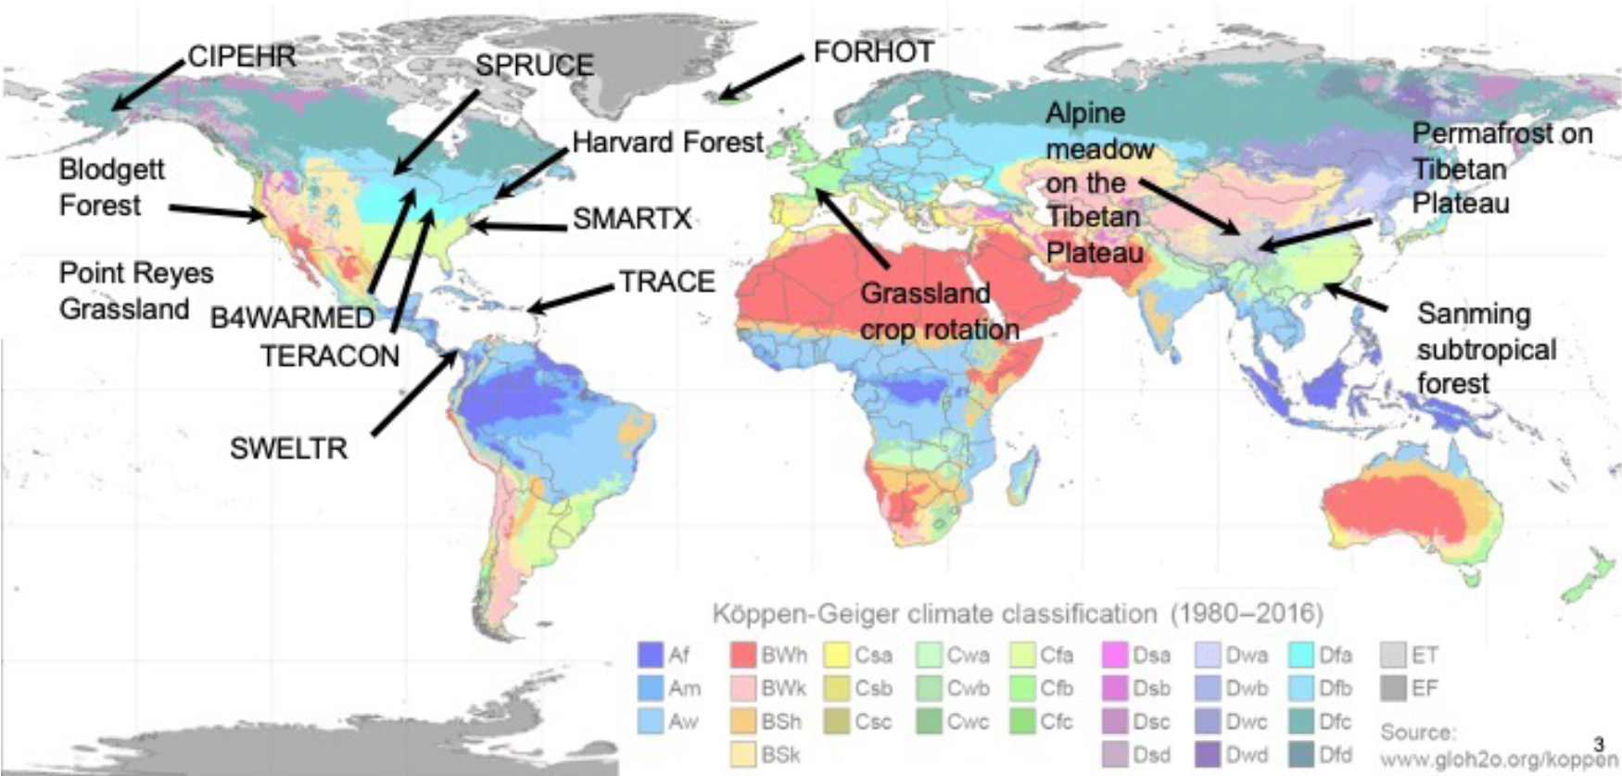
WARMING EXPERIMENTS
Alpine forest
figure from M. Schmidt
J. Beem-Miller
Notes:
Of these sites, 7 have nearly identical design with resistance heating rods extending greater than 1 m into the soil:
Pt. Reyes, Blodgett, SPRUCE, SMARTX, SWELTR, ACBB, TEAM
A further 6 have some combination of resistance heating rods and infrared surficial heating
B4WARMED, BioCon, Harvard Forest, TRACE, Achenkirch, Sanming
Two sites have other mechanisms of heating, e.g., CIPEHR (snow removal) and FORHOT (geothermal)

Slide 15
WHY DeepSoil 2100?
Whole soil warming
Global network
J. Beem-Miller

Slide 16
WHY DeepSoil 2100?
Whole soil warming
Global network
Model-data integration
Coordinated sampling
Benchmarking
J. Beem-Miller
Notes:
Network includes both empiricists and modelers
Opportunity to deploy coordinated sampling across sites
and to improve process understanding through model benchmarking efforts
I should note that while I’ve been emphasizing the soil response, we are also looking at what’s going on above ground
In particular, we’re focusing on warming effects on the coupling between below and above ground processes

Slide 17
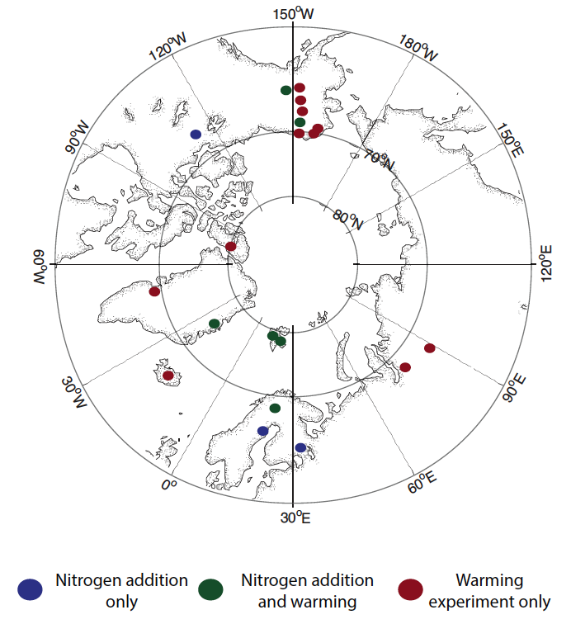
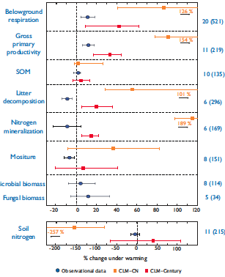
MODEL BENCHMARKING
figures from Bouskill et al., 2014
J. Beem-Miller
Bouskill et al., 2014. Meta-analysis of high-latitude nitrogen-addition and warming studies implies ecological mechanisms overlooked by land models. Biogeosciences, 11, 6969–6983
Notes:
Figures show example of how model-data integration can be used to benchmark models
A key approach in this project is to focus on process understanding, and the major challenge is to identify useful benchmarking measurements
e.g., ecosys model, developed by Riley and colleagues
CLM-CN differs from Century in three key ways: 4 pools, more open N cycling, faster [also “doesn’t resolve the vertical

Slide 18
WHY DeepSoil 2100?
Whole soil warming
Global network
Model-data integration
Coordinated sampling
Benchmarking
J. Beem-Miller

Slide 19
WHY DeepSoil 2100?
Whole soil warming
Global network
Model-data integration
Coordinated sampling
Benchmarking
Comparative approach
J. Beem-Miller
Notes:
All of the sites in the network were set up independently, and designed to answer specific questions
Largely united in the emphasis on constructing a carbon budget, but with different instrumentation, methodologies, and specific science questions
Can we gain a more nuanced, comprehensive understanding of which processes are affected in which settings? The first step is to create a synthesized database…

Slide 20
How hard can it be to build a database?
J. Beem-Miller

Slide 21
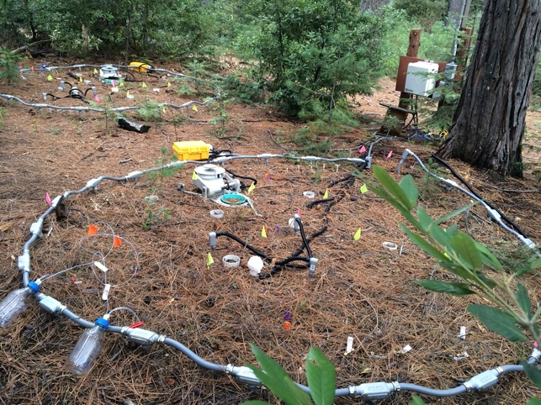
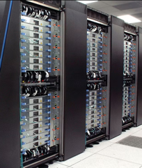
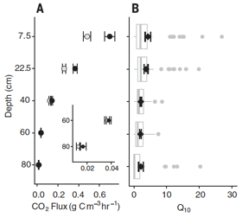


DATABASE PIPELINE
Raw data
Input
Data
Output
.csv
Photo credit: C. Hicks Pries
Output fig. from Hicks Pries et al. 2017
J. Beem-Miller
Notes:
Basic structure

Slide 22
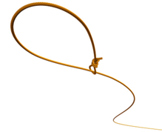
DATABASE PIPELINE
Harmonization/curation
Raw data
Input
Data
Output
.csv
Photo credit: C. Hicks Pries
Output fig. from Hicks Pries et al. 2017
J. Beem-Miller
Notes:
key step is translating raw data to harmonized format to facilitate analysis and synthesis (data “wrangling”)

Slide 23
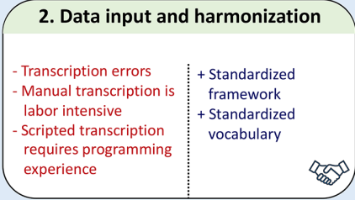
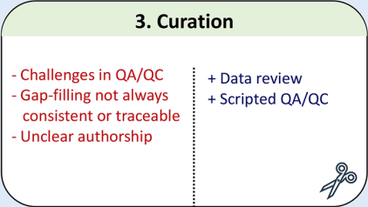
DATABASE PIPELINE
Harmonization/curation
Raw data
Input
Data
Output
.csv
Boxes from Fig. 1 of Todd-Brown et al. 2022
Photo credit: C. Hicks Pries
Output fig. from Hicks Pries et al. 2017
Todd-Brown et al., 2022. Reviews and syntheses: The promise of big diverse soil data, moving current practices towards future potential. Biogeosciences, 19, 3505–3522.
J. Beem-Miller
Notes:
translation: data model / data table converted to harmonized model
facilitates data provenance transparency

Slide 24


DATABASE PIPELINE
Harmonization/curation
Raw data
Input
Data
Output
.csv
Analysis
Processed data
Photo credit: C. Hicks Pries
Output fig. from Hicks Pries et al. 2017
J. Beem-Miller
Notes:
How do we query the database? (analysis)
How do we gap-fill/fix errors? (processed data)
How do we generate output? (reproducibility)

Slide 25
DATABASE PIPELINE
ISCN is headed in this direction
credit: Kathe Todd-Brown
Processed data
Raw data
Input
Harmonization
.csv
Analysis
Annotation
Output
Photo credit: C. Hicks Pries
Output fig. from Hicks Pries et al. 2017
.csv
J. Beem-Miller
Notes:
Query-driven
Minimize manual translations of data, which are error prone
Have searchable annotation files
Flexible & efficient

Slide 26
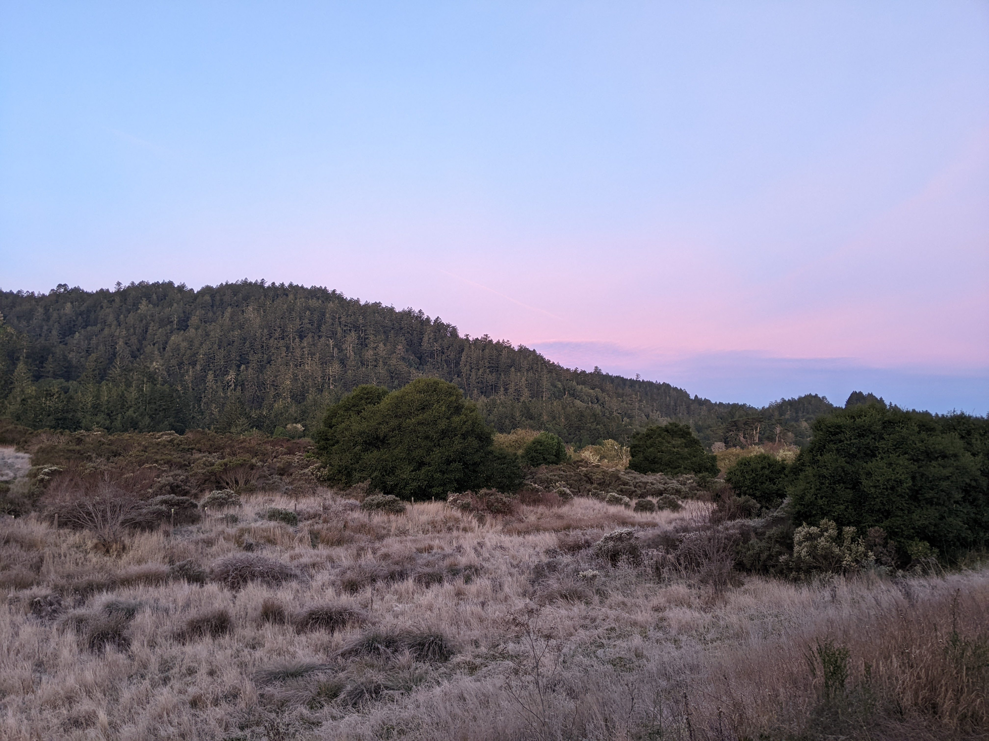
Thanks!
https://iscn.fluxdata.org/network/partner-networks/deepsoil2100/
Grassland Warming Experiment Site
Point Reyes, USA

Slide 27
DATABASE CHALLENGES
Defining a data model
J. Beem-Miller
Notes:
How are your data structured? What are the important levels?

Slide 28
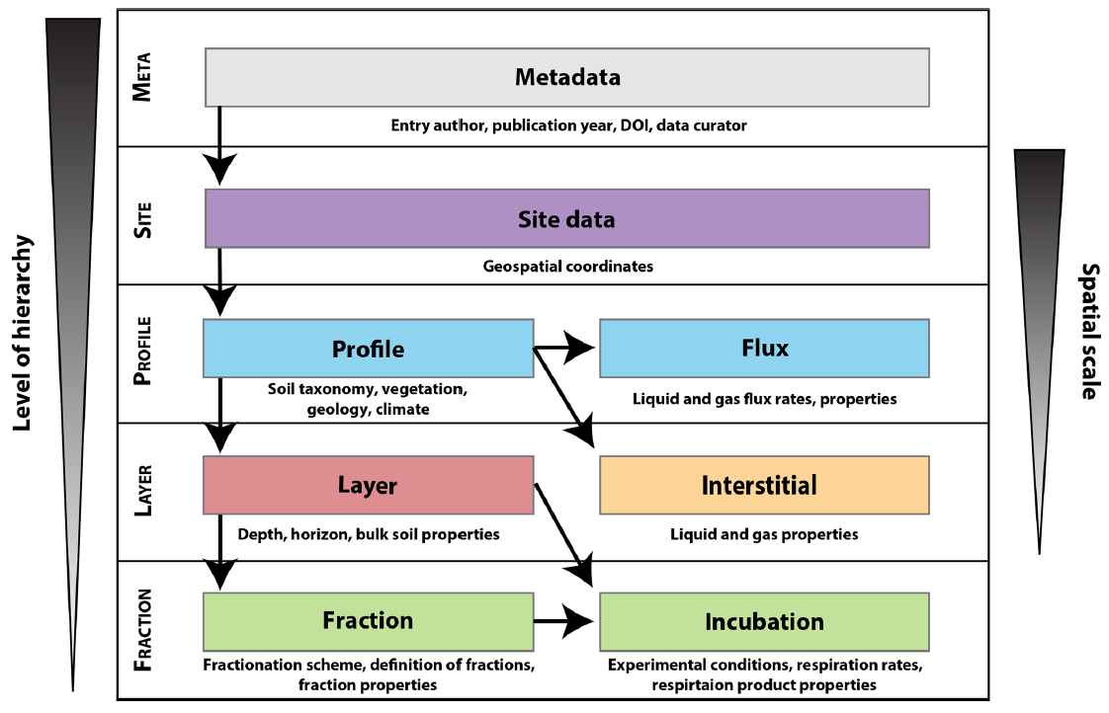
DATA MODEL EXAMPLE
ISRaD
“entry”
(based on ISCN)
figure from Lawrence et al., 2020
J. Beem-Miller
Lawrence et al., 2020. An open-source database for the synthesis of soil radiocarbon data: International Soil Radiocarbon Database (ISRaD) version 1.0. Earth Syst. Sci. Data, 12, 61–76.
Notes:
Need to define levels of hierarchy
How do levels “talk” to one another? e.g. “keys” / names
Time dimension?
Data interoperability, i.e., leveraging existing databases such as ISRaD, ISCN, SoDaH, FRED, etc.

Slide 29
DATABASE CHALLENGES
Defining a data model
Data transparency
J. Beem-Miller
Notes:
Tracing raw data through to the data product that has been quality controlled, filtered, aggregated, etc. is critical for reproduceability
DOIs are essential

Slide 30
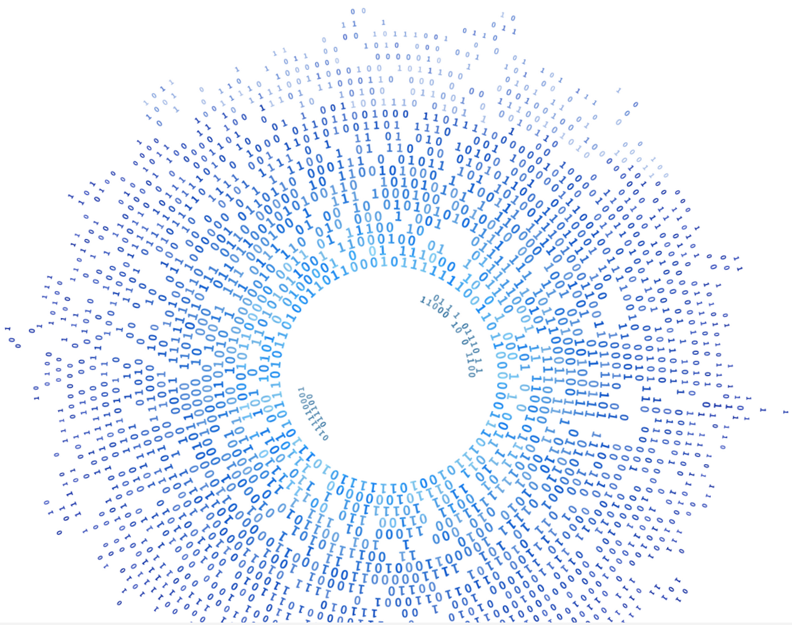
DATABASE CHALLENGES
Defining a data model
Data transparency
DOI
J. Beem-Miller
Notes:
Tracing raw data through to the data product that has been quality controlled, filtered, aggregated, etc. is critical for reproduceability
DOIs are essential

Slide 31
DATABASE CHALLENGES
Defining a data model
Data transparency
Data ingestion vs analysis
J. Beem-Miller
Notes:
A database that is optimized for data entry is not always simple to query or use for analysis
Different users have different needs

Slide 32
DATABASE CHALLENGES
Defining a data model
Data transparency
Data ingestion vs analysis
Mapping disparate data to harmonized values
J. Beem-Miller
Notes:
Data from different groups can be produced through different methodologies…
or may be collected at different frequencies or depths…
or be reported with different units.
How do we make sure that all these data streams can be harmonized into a coherent dataset?

Slide 33
DATABASE CHALLENGES
Defining a data model
Data transparency
Data ingestion vs analysis
Mapping disparate data to harmonized values
Tradeoff of flexibility vs. control
J. Beem-Miller
Notes:
When designing a database it is easy to get caught up in difficult discussions of appropriate vocabulary and decide on consistent nomenclature
Having a rigidly defined template can help streamline QA/QC (particularly when automated)
But this is a lot of work to implement, and makes data entry formidable

Slide 34
DATABASE CHALLENGES
Defining a data model
Data transparency
Data ingestion vs analysis
Mapping disparate data to harmonized values
Tradeoff of flexibility vs. control
Data access
J. Beem-Miller
Notes:
Finally, a good database should also be easy to use

Slide 35
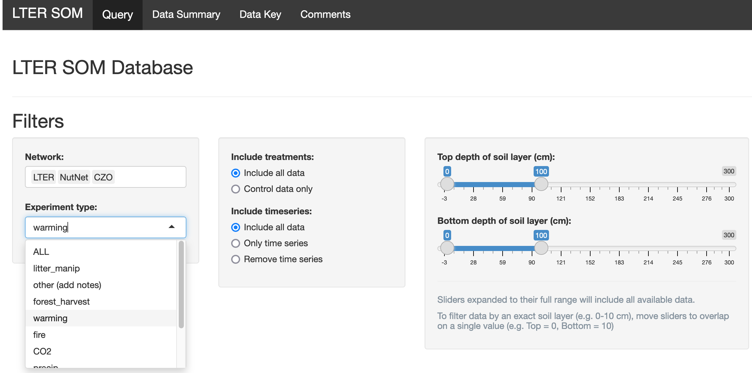
DATABASE CHALLENGES
SoDaH
web interface
(shiny)
Figure from Wieder et al., 2021
J. Beem-Miller
Wieder et al., 2021. SoDaH: The SOils DAta Harmonization database, an open-source synthesis of soil data from research networks, version 1.0. Earth System Science Data, 13, 1843-1854.
Notes:
Finally, a good database should also be easy to use

Slide 36
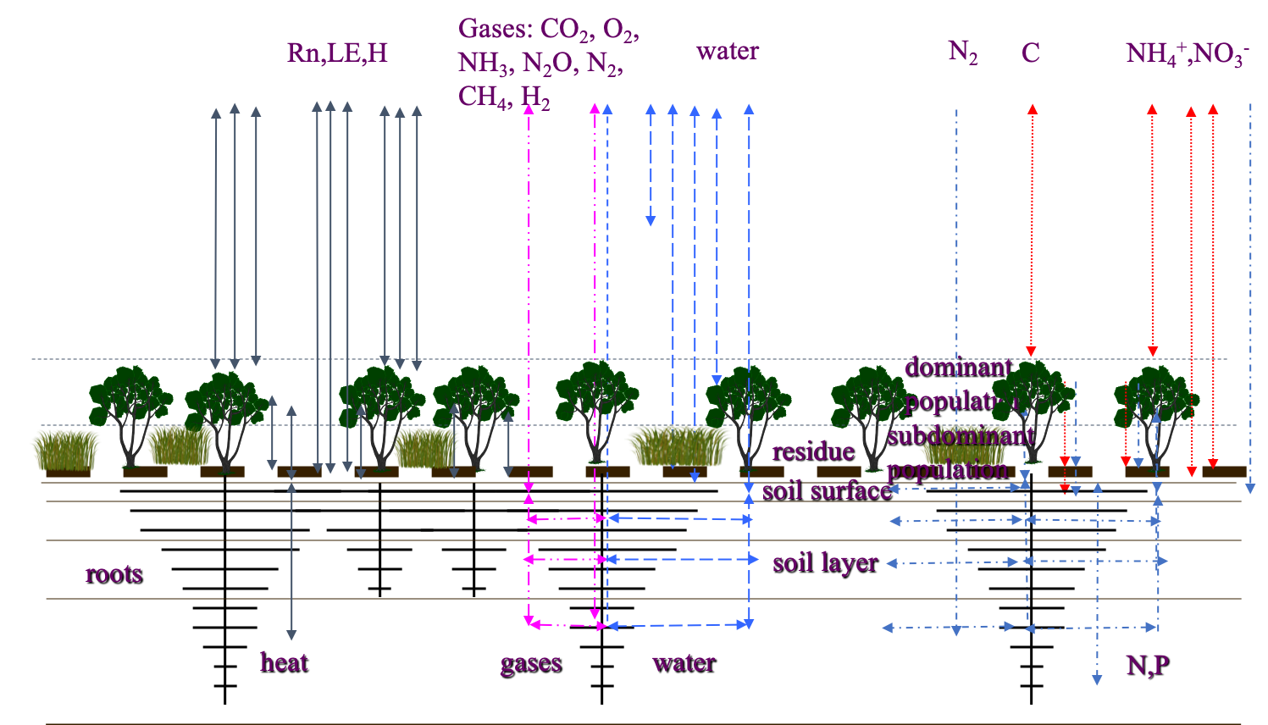
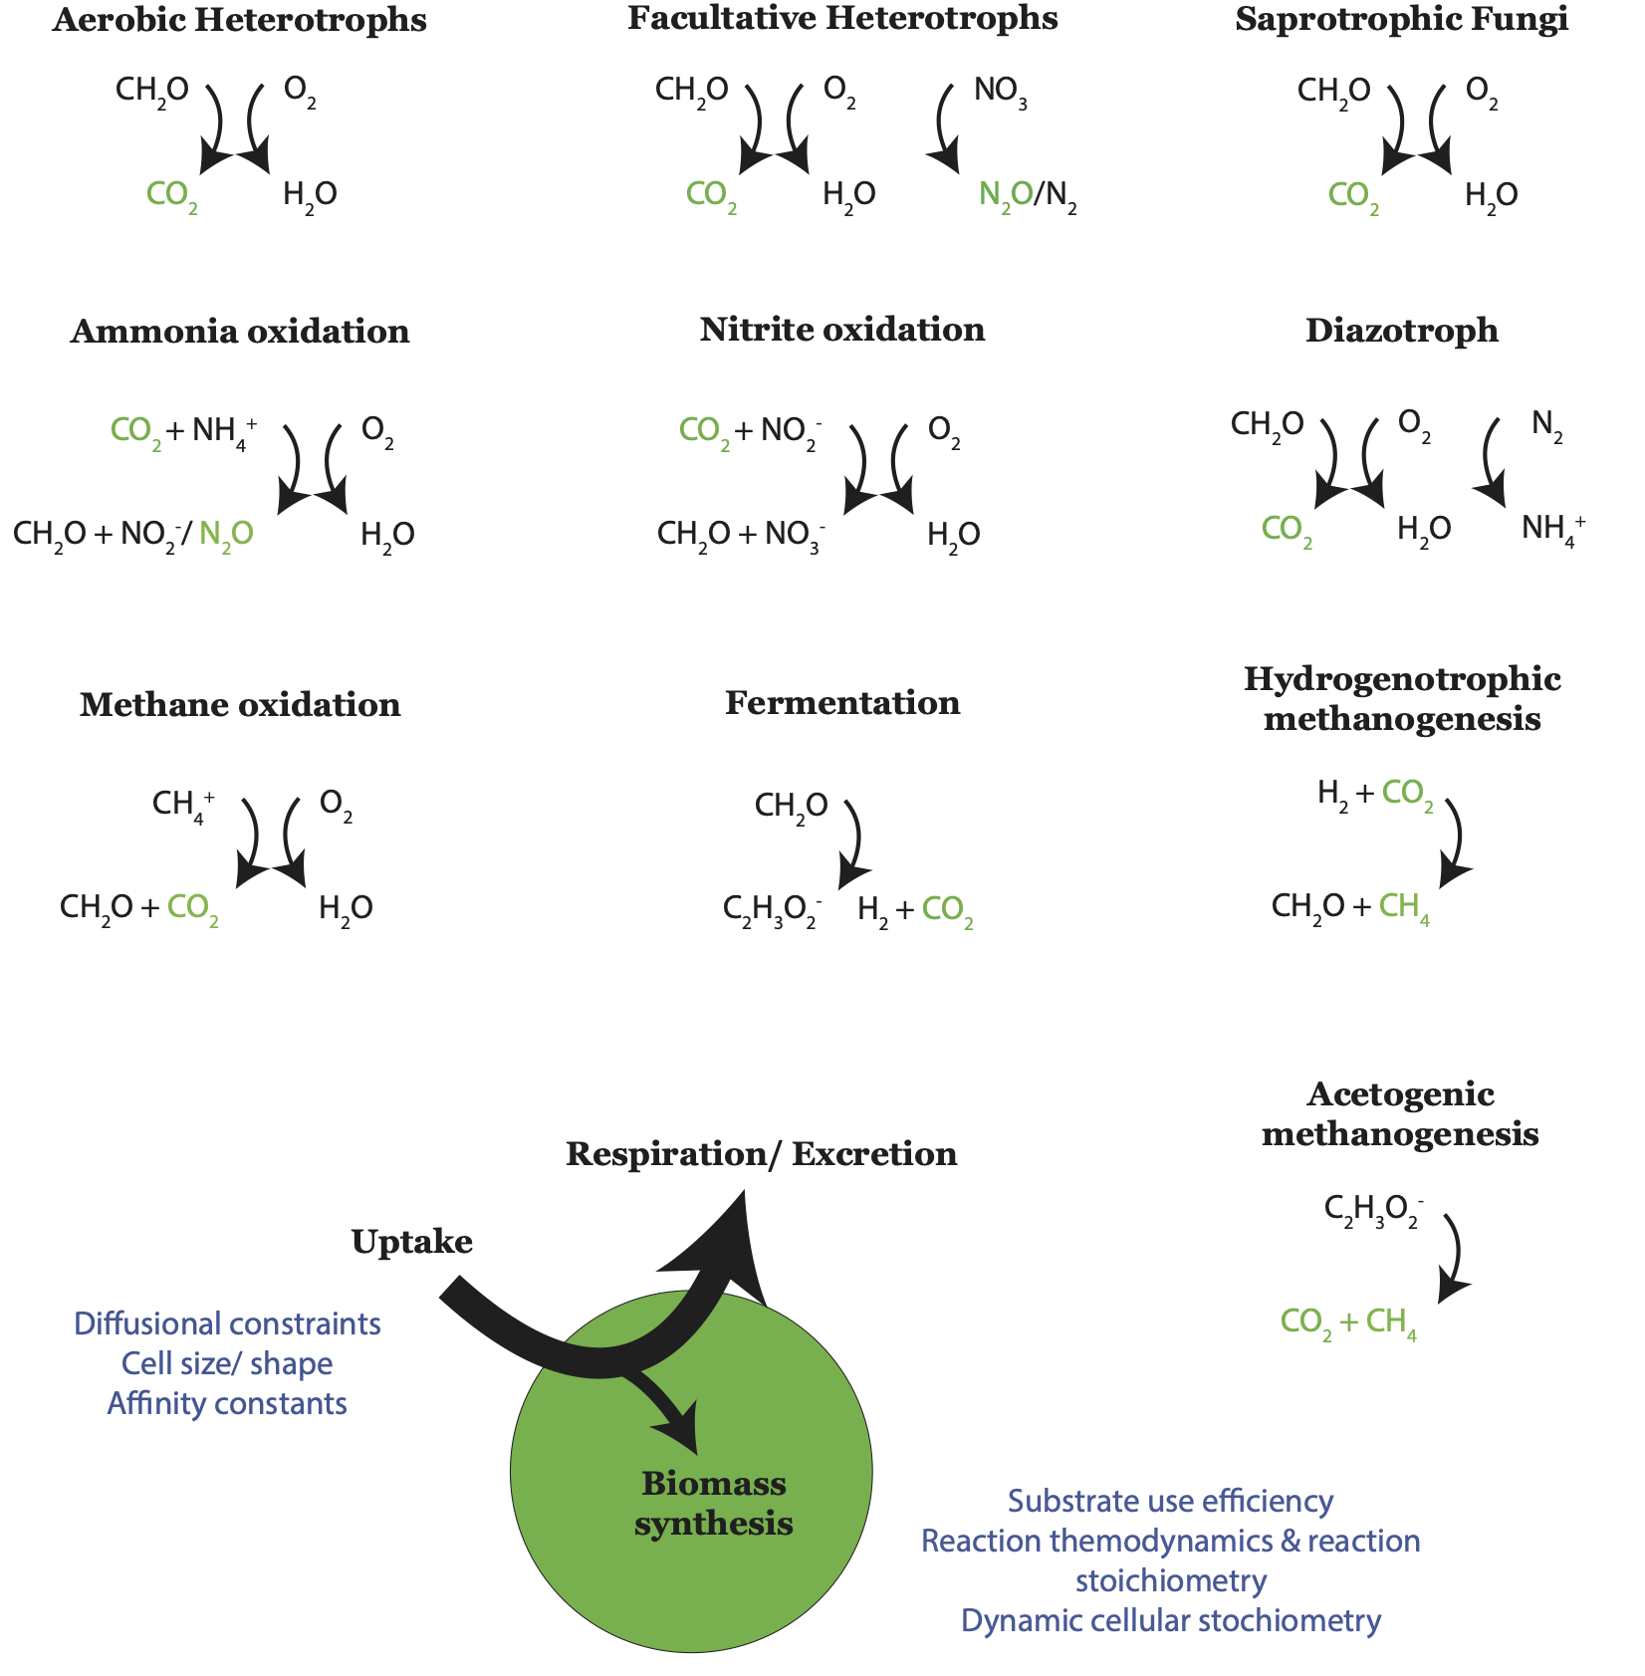
MODEL BENCHMARKING
ecoSys Model
(figures from W. Riley)
J. Beem-Miller
Notes:
ecosys is a detailed site-level model that can be applied regionally
Can be applied in 2D and 3D configurations at site scale
This is a microbially explicit model
and also includes vegetation demography

Slide 37
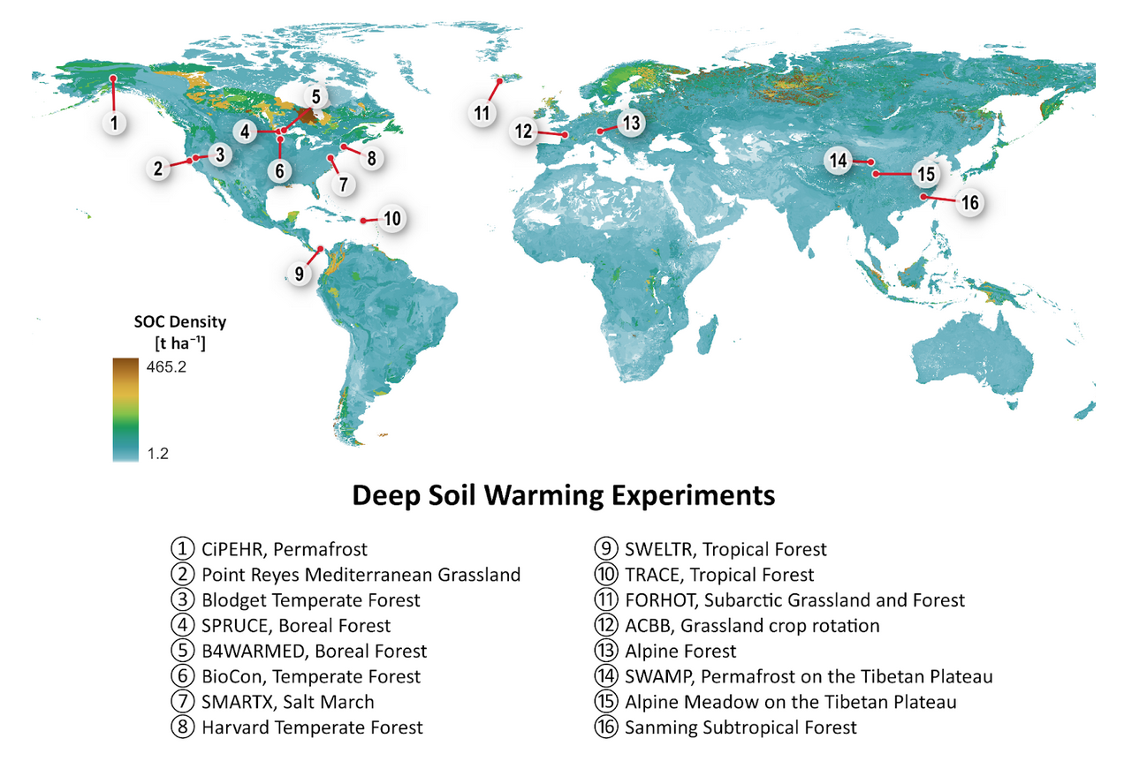
WARMING EXPERIMENTS
J. Beem-Miller
Notes:
Goal oriented---what queries will you make?
Required data?
Metadata: data curation---who, where, when, etc.
Governance: who’s in charge?

Slide 38
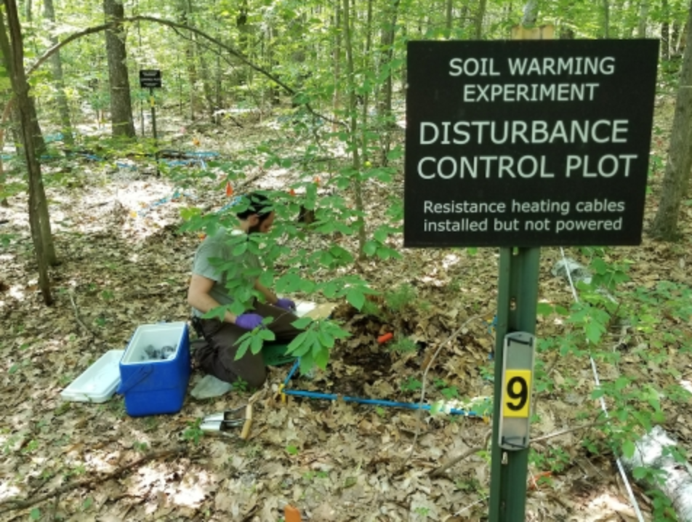
WHY DeepSoil 2100?
J. Beem-Miller
Notes:
Goal oriented---what queries will you make?
Required data?
Metadata: data curation---who, where, when, etc.
Governance: who’s in charge?

